Slide 1
TTEST and ANOVA
14
the theory
Probability
and
Statistics
COMS10011
Dr. Anne Roudaut
csxar@bristol.ac.uk

Slide 2
before we start a quick reminder

Slide 3
I’M a DR
Independent
Responses
Manipulated
Dependent
Dependent vs Independent variables?

Slide 4
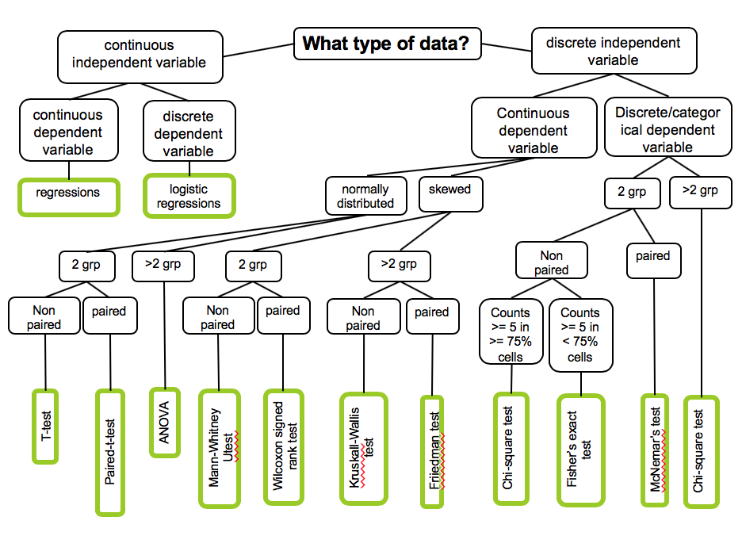
Likert are Ordinal but can be treated as Continuous

Slide 5
lets go back to our memorization experience

Slide 6
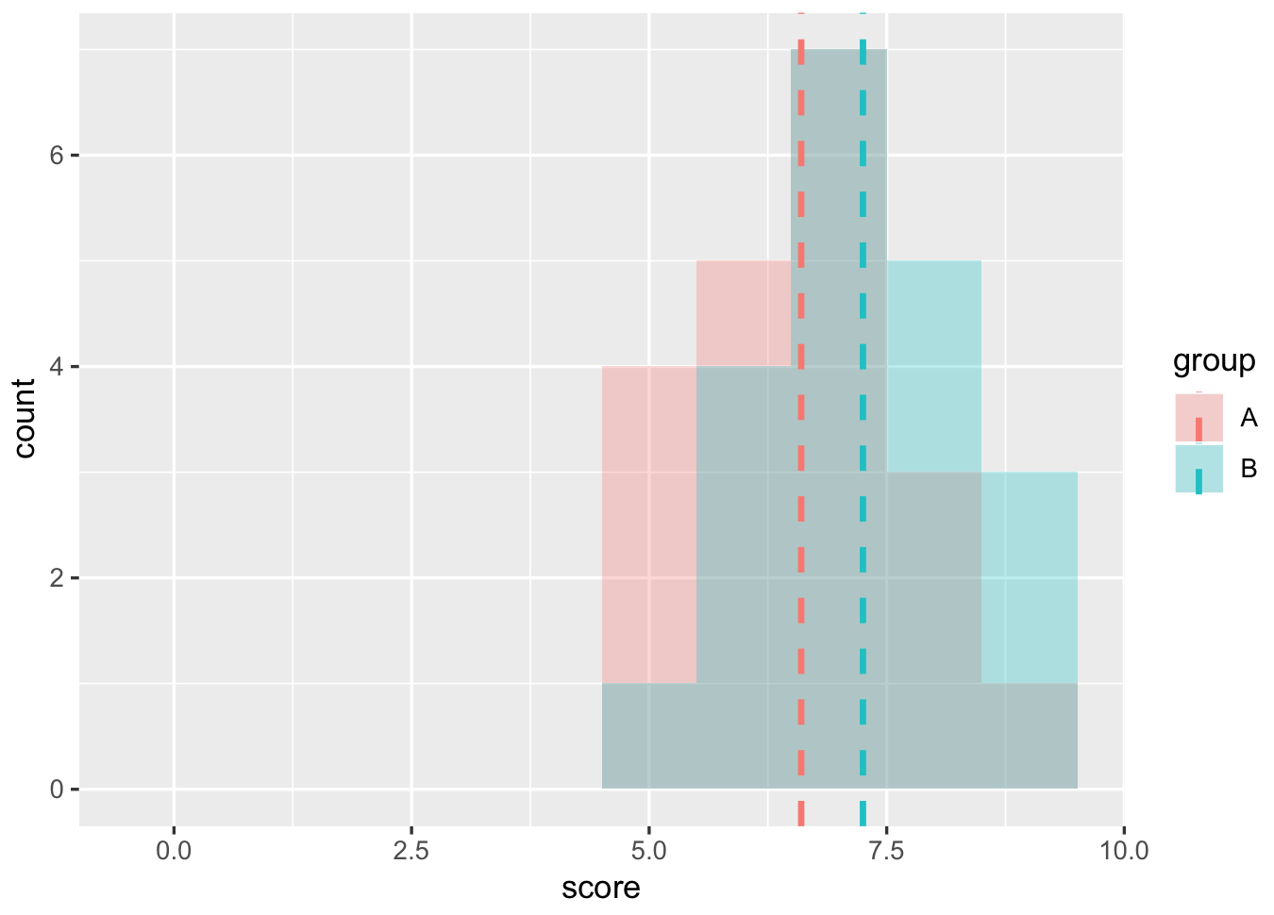
no evidences for chocolate vs. baseline (p>0.05)

Slide 7
count
memorization score
no evidences for chocolate vs. baseline (p>0.05)
(let’s just assume these are normally distributed)

Slide 8
count
probably
p<0.05
memorization score
if the mean where further apart, it would increase our chances to have a p<0.05

Slide 9
count
memorization score
<without changing the means, what else can we do to these data to make some more different?>

Slide 10
count
probably
p<0.05
memorization score
if the distributions where less spread out, it would increase our chances to have a p<0.05

Slide 11
count
signal
memorization score
noise
the goal of a study is to find
a signal in a lot of noise

Slide 12
any statistical tests ::
signal
noise

Slide 13
signal
T-tests ::
noise
difference between group means
variability of groups

Slide 14
signal
noise
T-tests ::
difference between group means
variability of groups

Slide 15
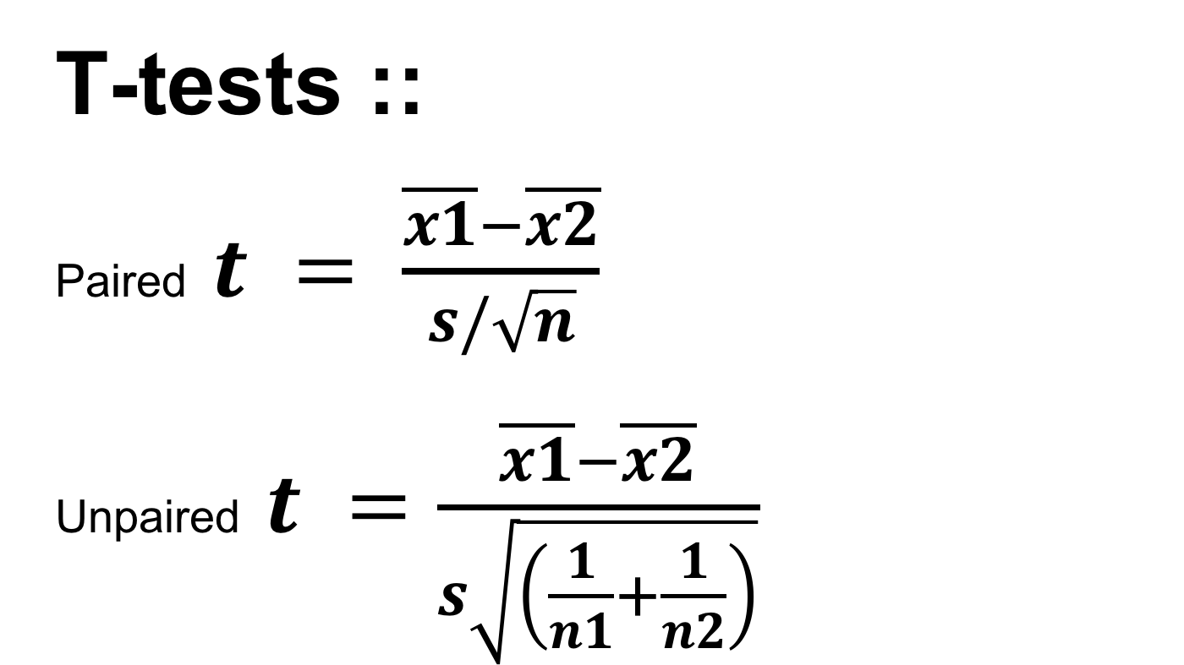
T-tests ::
Paired $t = \frac{\overline{x1}−\overline{x2}}{s/\sqrt{n}}$
Unpaired $t =\frac{\overline{x1}−\overline{x2}}{s\sqrt{\left(\frac{1}{n1}+\frac{1}{n2}\right)}}$

Slide 16
paired t-test

Slide 17
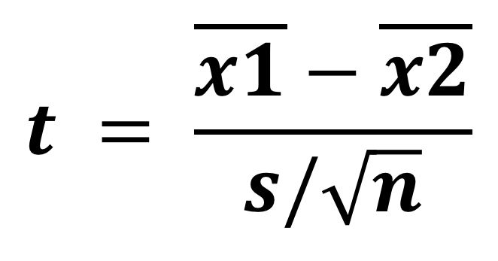
different between group means
(to maximize)
$$t = \frac{\overline{x1}−\overline{x2}}{s/\sqrt{n}}$$
standard deviation
of the differences
(to minimize)

Slide 18
different between group means
(to maximize)
$$t = \frac{\overline{x1}−\overline{x2}}{s/\sqrt{n}}$$
standard error of the mean
(to minimize)
but why do we need to divide by $\sqrt{n}$ (n = sample size)?

Slide 19
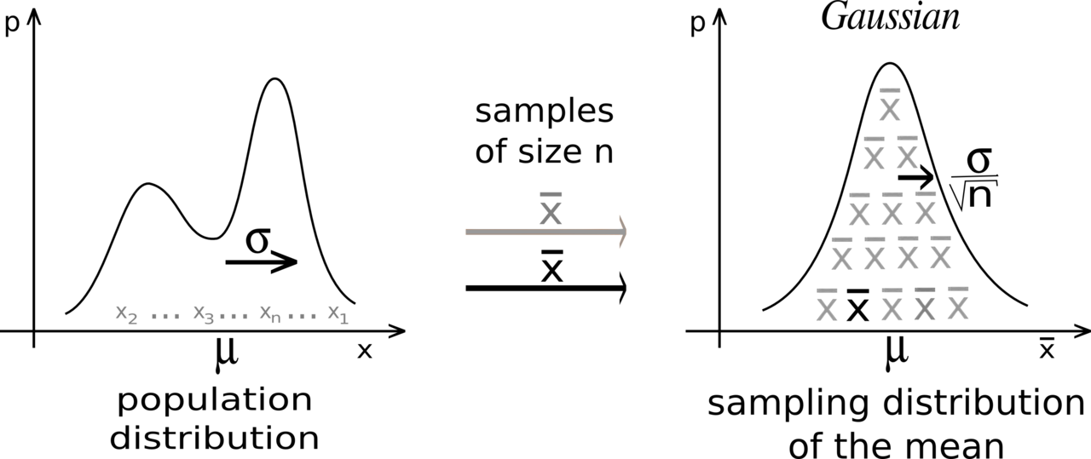
this comes from the central limit theorem you have seen before (lecture 10)

Slide 20
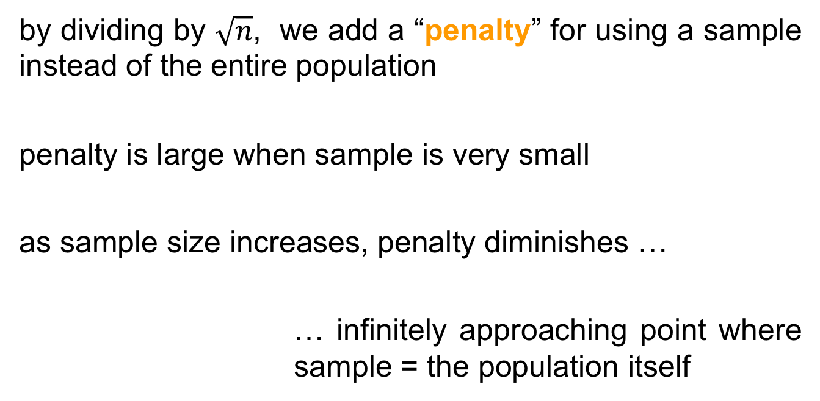
by dividing by $\sqrt{n}$, we add a “penalty” for using a sample instead of the entire population
penalty is large when sample is very small
as sample size increases, penalty diminishes …
… infinitely approaching point where sample = the population itself

Slide 21
$$t = \frac{\overline{x1}−\overline{x2}}{s/\sqrt{n}}$$
we get a t-value
(to maximize)

Slide 22
both signal and noise are in the units of your data
If signal = 6 and noise = 2, your t-value = 3, so the difference is 3 times the size of the standard error
If signal = 6 and noise = 6, your t-value = 1, the signal is at the same scale as the noise
t-values = how distinguishable signal from noise

Slide 23
how do we know our t-value is any good, and how does this related to p-value?
this is where t-distributions come in

Slide 24
studyX
study1
t=0.9
t=1.5
population
study2
…
t=1.4
study4
study3
t=1.1
t=0.9
now let’s take all these possible values and …
Notes:
When you perform a t-test for a single study, you obtain a single t-value. However, if we drew multiple random samples of the same size from the same population and performed the same t-test, we would obtain many t-values and we could plot a distribution of all of them

Slide 25
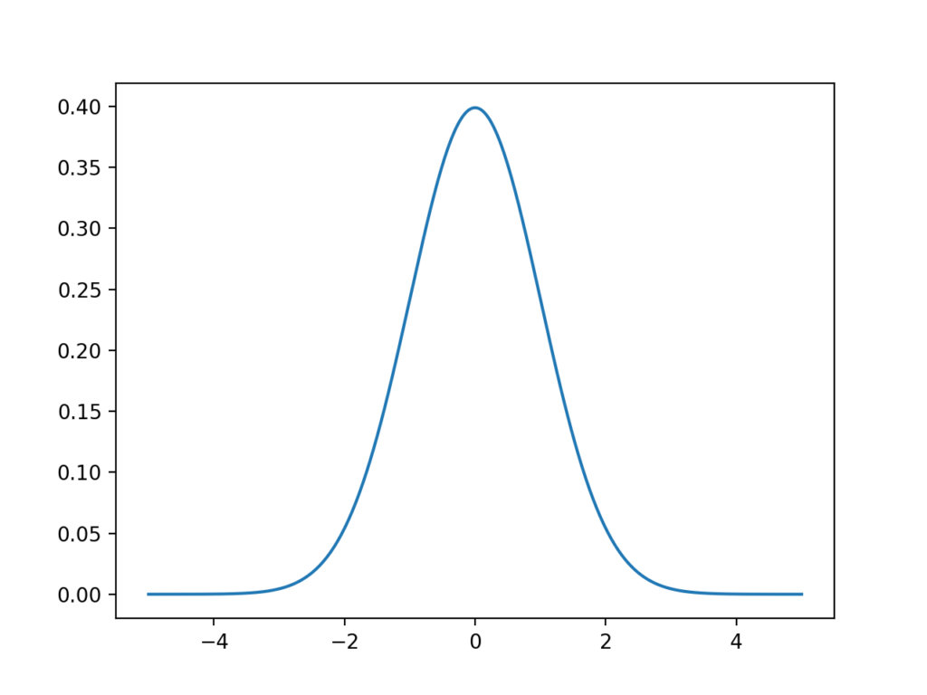
t-value
… plot a distribution of them
this type of distribution is a sampling distribution

Slide 26
fortunately, the properties of t-distributions are well understood in statistics, so we can plot them without having to collect many samples!
a specific t-distribution is defined by its degrees of freedom (DF), a value closely related to sample size (here n-1)
different t-distributions exist for every sample size

Slide 27
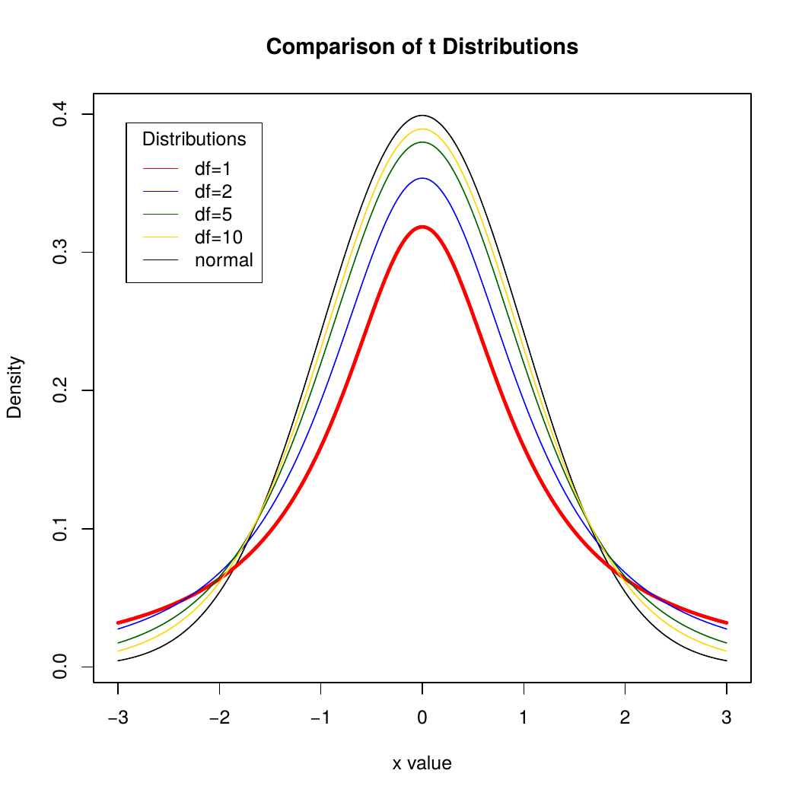
t-value

Slide 28
t-distributions assume that you draw repeated random samples from a population where the null hypothesis is true. You place the t-value from your study in the t-distribution to determine how consistent your results are with the null hypothesis.

Slide 29
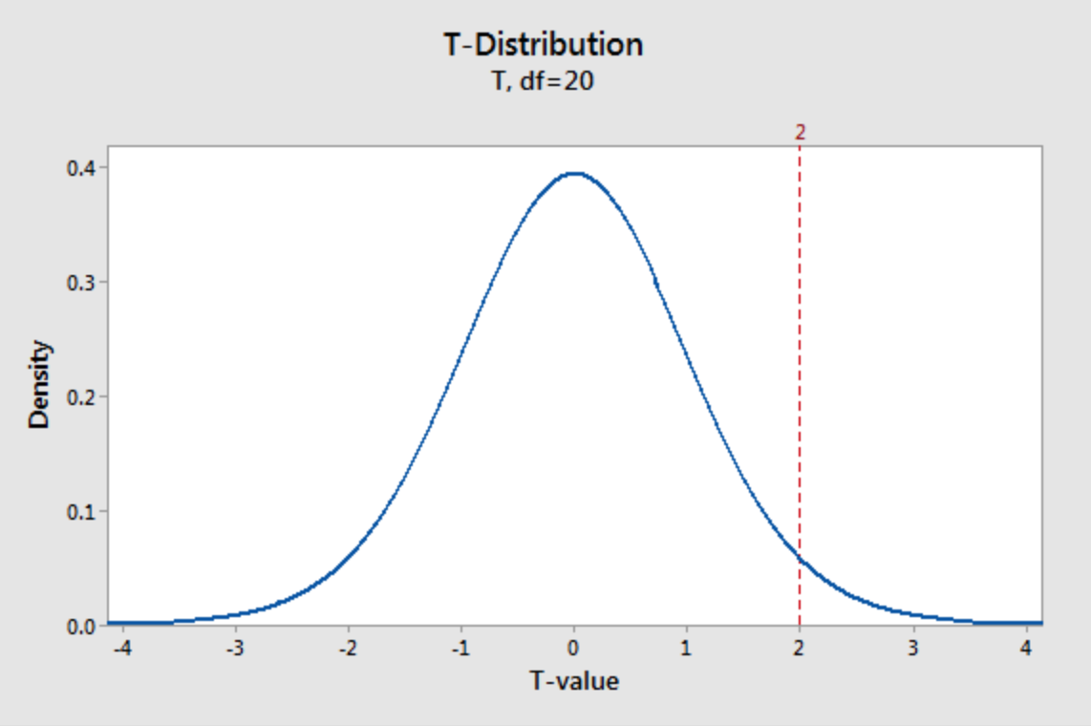
imagine a t-value of 2
seems unusual but how exactly unusual?
e.g. here a t-distribution (DF =20 which means a sample size of 21). It plots the probability density function (PDF), which describes the likelihood of each t-value.

Slide 30
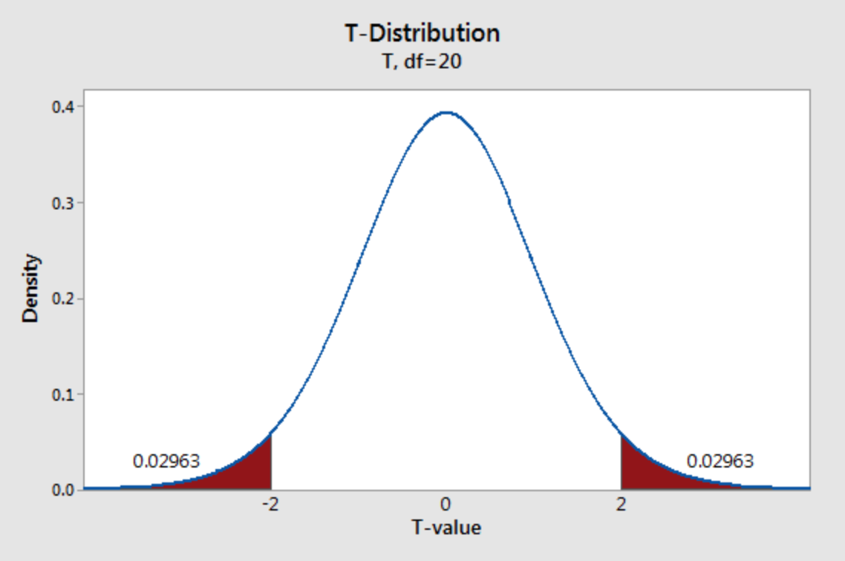
shade the area of the curve with t-values >2 and <-2
each regions has a probability of 0.02963, which sums to a total probability of 0.05926.

Slide 31
when the null hypothesis is true, the t-value falls within these regions nearly 5.9% of the time …
… this is our pvalue!

Slide 32
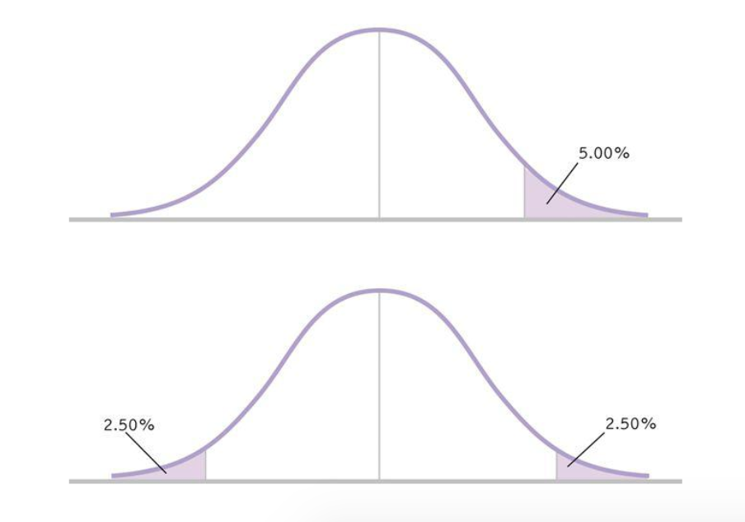
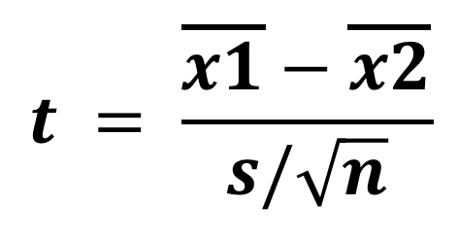
one-tail
$$t = \frac{\overline{x1}−\overline{x2}}{s/\sqrt{n}}$$
two-tails
it also does explain one-tail vs. two tails t-tests: one-tail only case about t=2 (not -2 or oppositely), so multiply pvalue by two.

Slide 33
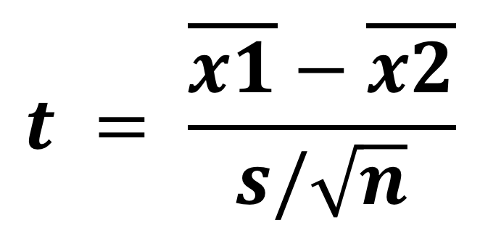
at this point you understand more the three reasons of a low p_value (or t_value)
1. difference not large enough
(what you are searching for, your signal is weak)
$$t = \frac{\overline{x1}−\overline{x2}}{s/\sqrt{n}}$$
2. too much noise
(could your experimental design introduce noise? Check it)
3. not enough data
(run more participants, gather more trials)

Slide 34
how much data is enough?

Slide 35
the larger the sample size, the more t-distributions become a z-distribution (at around n=30), the less the area under the curve to reach a low p_value.

Slide 36
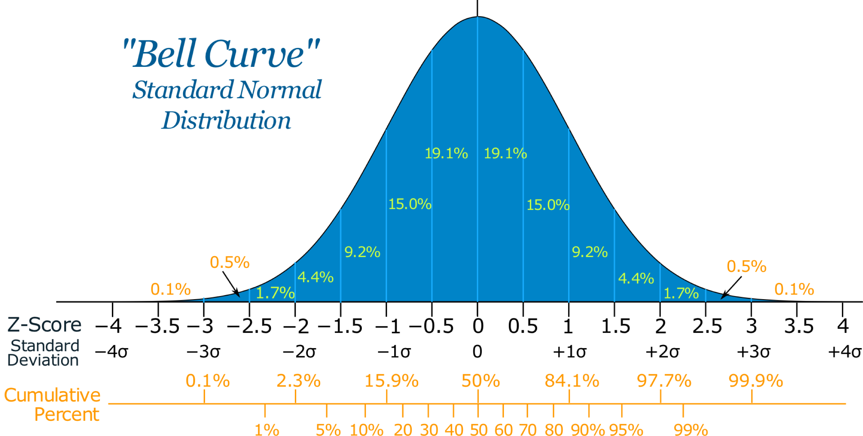
back to using a Z-score (i.e. number of standard deviations from the mean on normal distribution)

Slide 37
so why using a t-test then?
well there are cases when we want to use less sample to speed up the evaluation
this was the case of William Sealy Gosset …

Slide 38
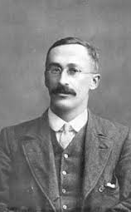

Employee of Guiness, Gosset developed a small sample method to select the best yielding varieties of barley.
Biometricians like Pearson typically had hundreds of observations.
Guinness allowed him to publish his method under the name “Student” to prevent disclosure of confidential information.
Where do t-distrubitions came from?
https://www.youtube.com/watch?v=NvUDvmrd6fo&feature=youtu.be

Slide 39
now it does not mean that 2 sample is enough … a rule of thumb for a simple within experiment is 12-16 participants for example (and twice more for between experiment).
… we will actually look at how to know if you sample size is good in the lecture 18

Slide 40
unpaired t-test

Slide 41
T-tests ::
Paired $t = \frac{\overline{x1}−\overline{x2}}{s/\sqrt{n}}$
Unpaired $t =\frac{\overline{x1}−\overline{x2}}{s\sqrt{\left(\frac{1}{n1}+\frac{1}{n2}\right)}}$
similar than paired t-test except this

Slide 42
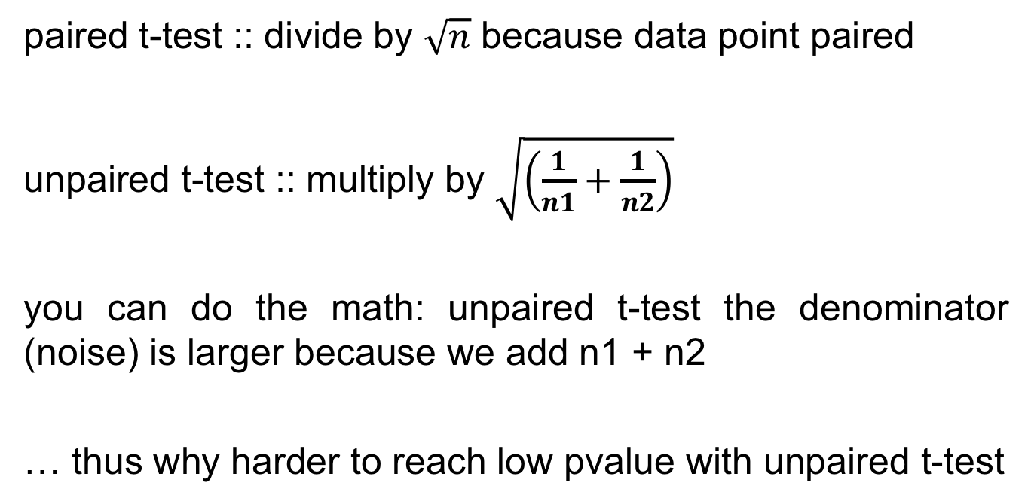
paired t-test :: divide by $\sqrt{n}$ because data point paired
unpaired t-test :: multiply by $\sqrt{\left(\frac{1}{n1}+\frac{1}{n2}\right)}$
you can do the math: unpaired t-test the denominator (noise) is larger because we add n1 + n2
… thus why harder to reach low pvalue with unpaired t-test

Slide 43
practically

Slide 44
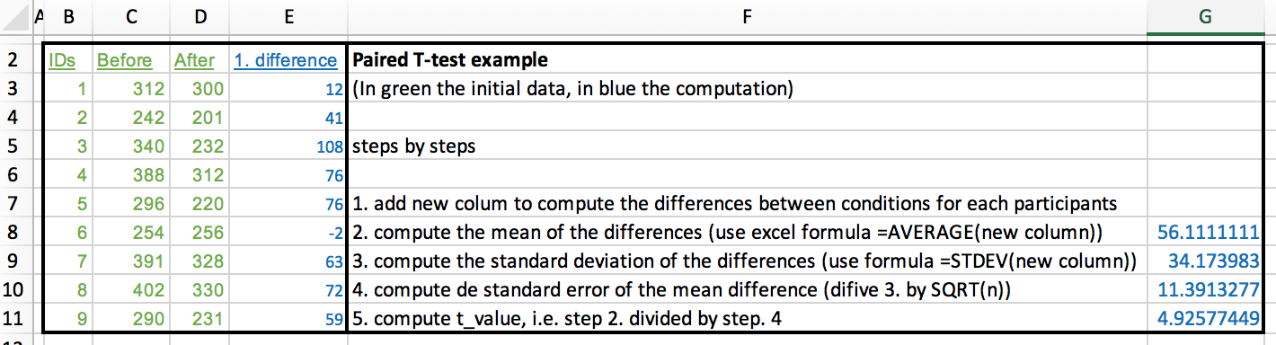
(excel file in the git hub repository)

Slide 45
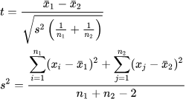
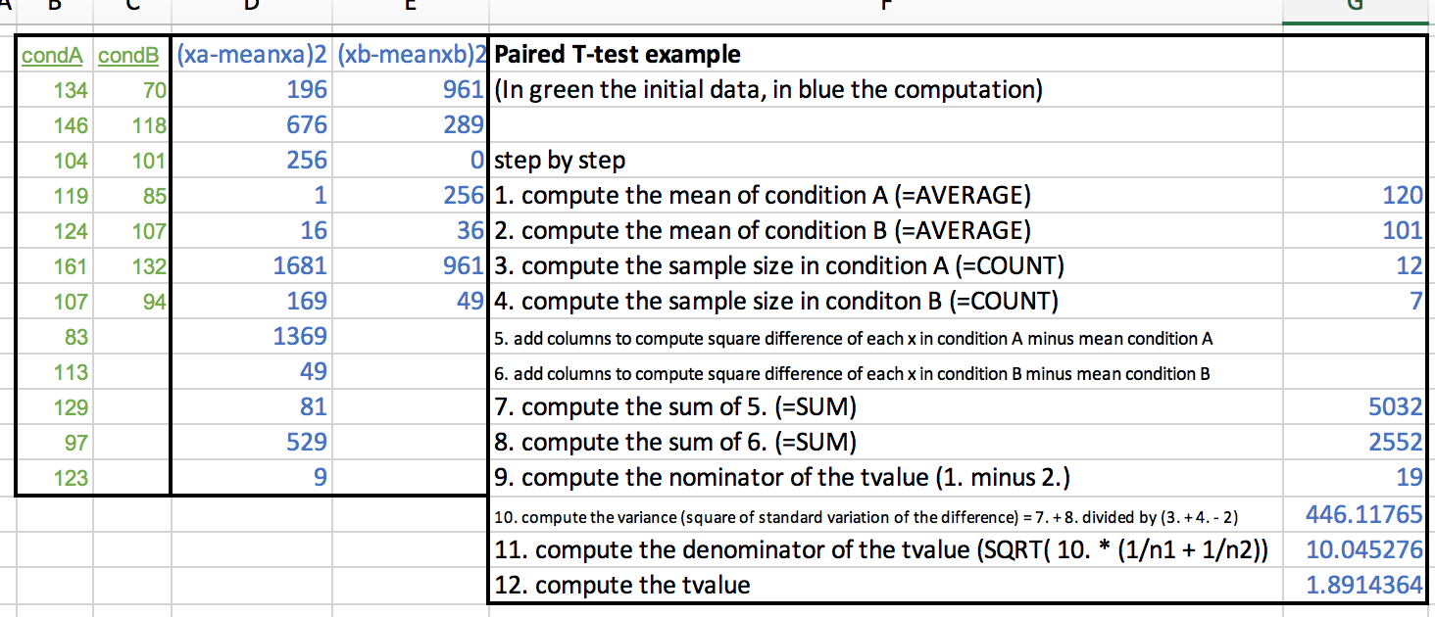
(excel file in the git hub repository)

Slide 46
anovas

Slide 47
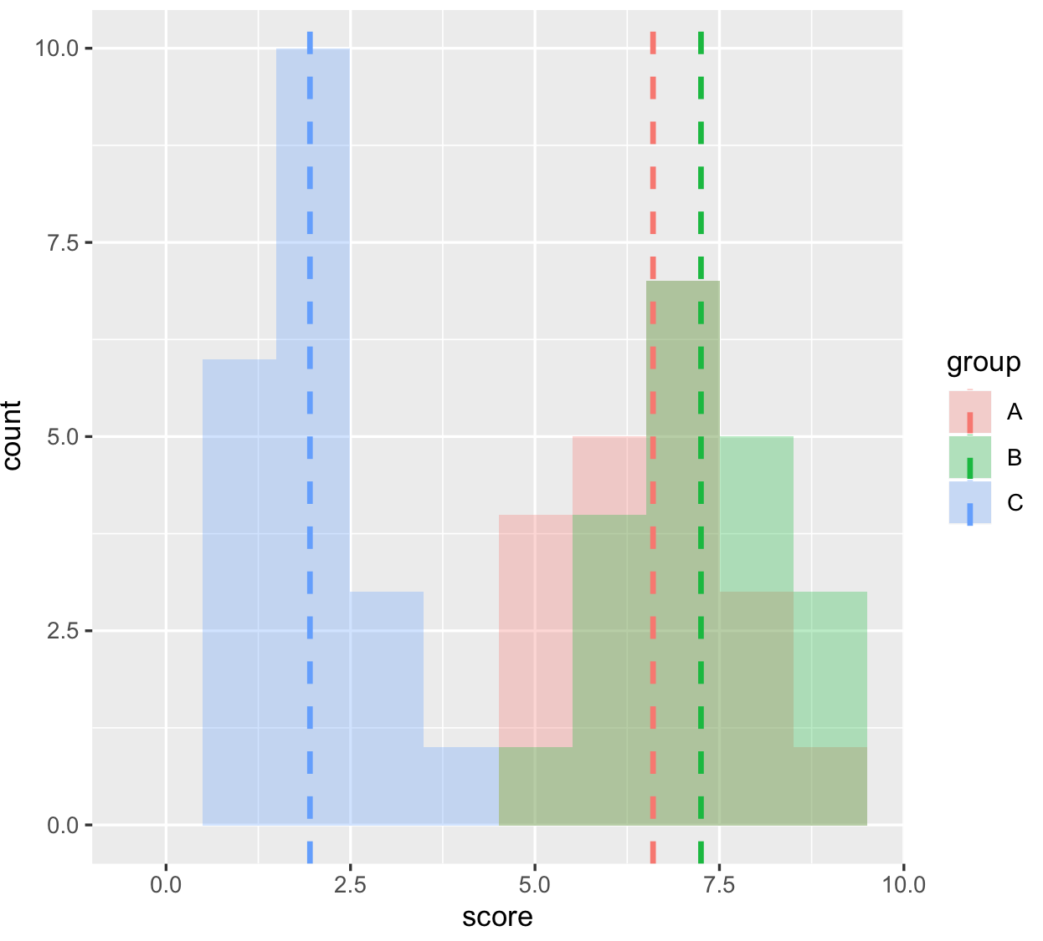

Slide 48
count
memorization score
(let’s assume again these are normally distributed)

Slide 49
any statistical tests ::
signal
noise

Slide 50
signal
ANOVA ::
noise
difference between group means
variability of groups

Slide 51
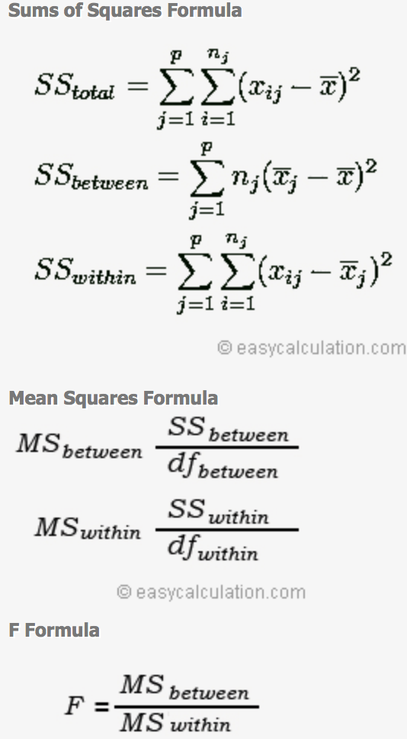
ANOVA ::

Slide 52
don’t be afraid by this

Slide 53
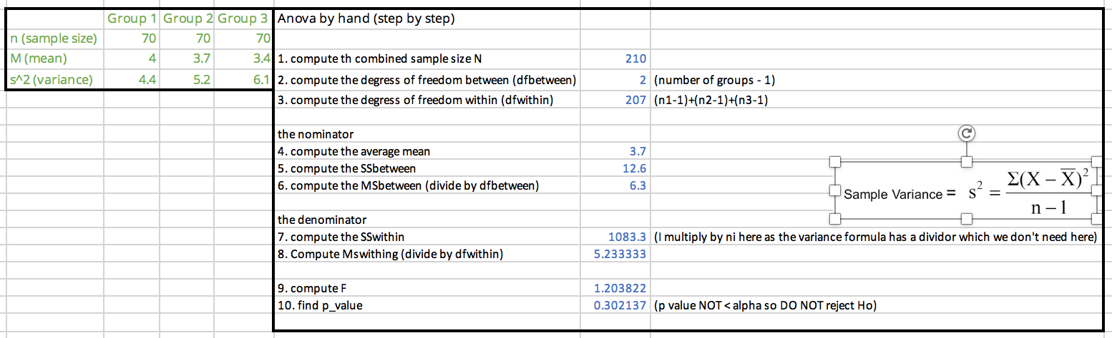
(excel file in the git hub repository)

Slide 54
how do we know if the Fvalue is anygood?
… this is where F-distributions come in

Slide 55
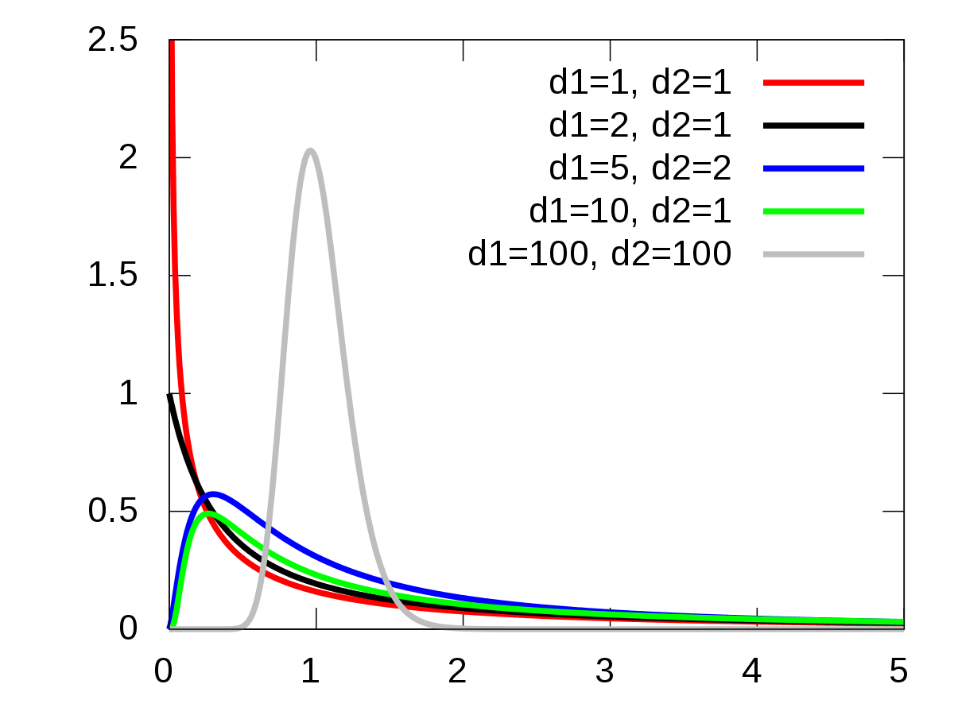
they take two degrees of freedom rather than just one like with t-distributions

Slide 56
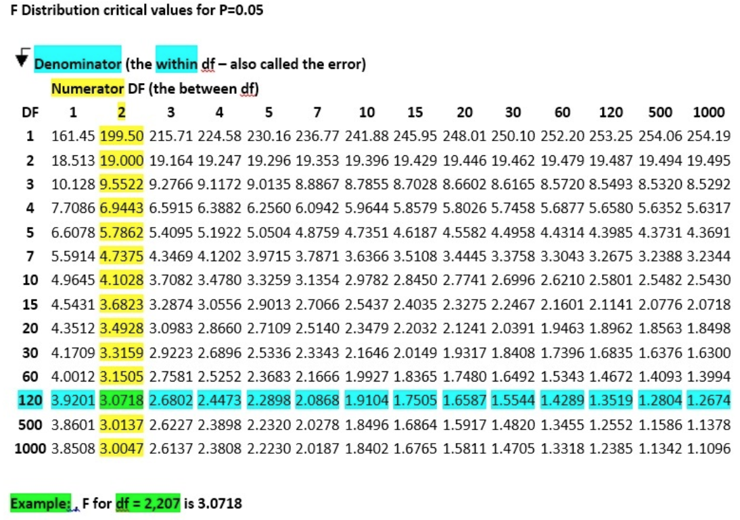
also in form of table (here for the dfwithin and dfbetween of our excel example)

Slide 57
R
# first we run the one-way anova
library(ez)
ezANOVA(dat,id,between=group,dv=score)
Effect DFn DFd F p p<.05 ges
1 group 2 57 154.8886 9.056612e-24 * 0.8445923
# second, run the pairwise comparison
pairwise.t.test(dat$score,dat$group, paired=FALSE, p.adjust.method="bonferroni")
A B
B 0.16 -
C <2e-16 <2e-16
ok something is going
to be interesting here
here are significant differences
and we don’t need to do the Bonferroni correction (already included)
this was from last week, R gives us all this numbers
Notes:
head(cars) # cars is a table that already comes with R and contain 50 observations of speed and distance in two rows
scatter.smooth(x=cars$speed, y=cars$dist, main="Dist ~ Speed") # scatterplot
linearMod <- lm(dist ~ speed, data=cars) # build linear regression model on full data
summary(linearMod) # summary(linearMod)$r.squared
abline(linearMod, col="blue")

Slide 58
degrees of freedom

Slide 59
degrees of freedom::
the number of values in the final calculation of a statistic that are free to vary
a complex notion but here is the intuition …

Slide 60
you have 7 hats, you want to wear one different every day for a week
Monday: 7 choices
Tuesday: 6 choices
Wednesday: 5 choices
Thursday: 4 choices
Friday: 3 choices
Saturday: 2 choices
Sunday: NO choice
degrees of freedom is 7-1

Slide 61
if we have 7 observations and the mean of these observation (that you need to do t-test or Anova) your degree of freedom is 7-1
because if you know 6 observations you automatically know the 7th one (thanks to the mean)

Slide 62
remember the lecture on regression?

Slide 63
1
standard error of the estimate
T time
(ms)
Fitts! T = 2.3 + 1.1 ID
ˆ
∑ (estimated y – actual y)²
(sample size-2)
ID index of difficulty
also called degree of freedom

Slide 64
a simple (approximate) way to understand this is that we have two variables, the slope and the intercept of the regression line
that give us extra information, thus the minus 2

Slide 65
summary

Slide 66
take away
Explain the general equation of a statistical test (signal/noise)
Explain how a t-test is computed and be able to do it by hand
Explain the 3 reasons why a t-value can be low (signal too low, noise too high, small sample)
Explain how a Anova is computed, and be able to do it by hand
Explain what are t-distributions and f-distributions

Slide 67
end

